Slide 1
Project 102 Mid-year progress video
Krithik Lekinwala & Shreya Singaraju

Slide 2
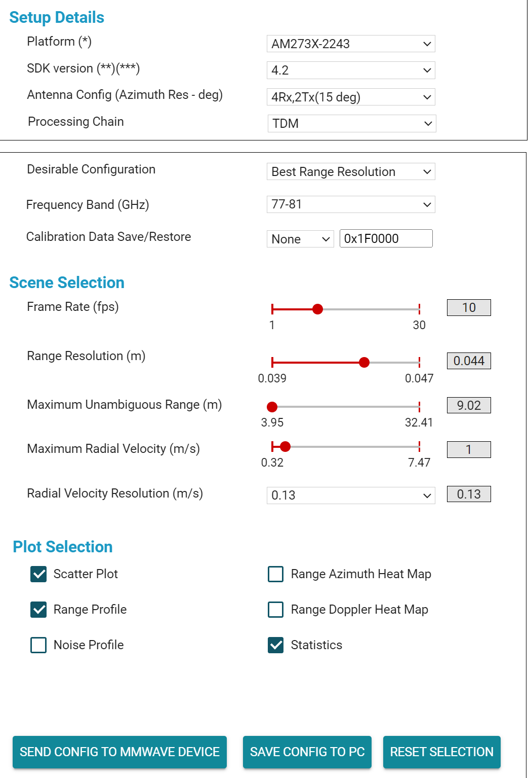
Texas instruments visualiser
Allows control for a variety of sensor parameters and plots
Plug in mmWave sensor and see real-time data output
Texas Instruments mmWave Demo Visualizer parameters

Slide 3
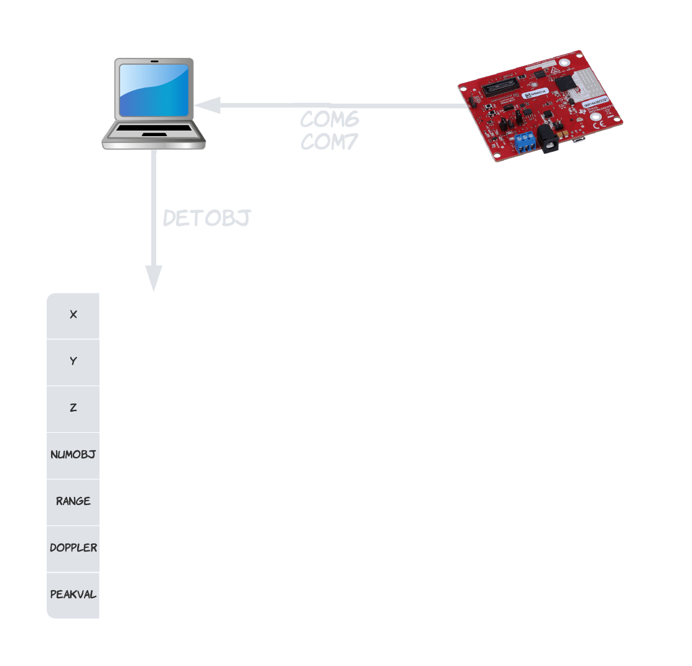
Python parser
PC reads sensor data through COM6 & COM7
Parser accesses ports and converts bytes to readable data
Output is dictionary with parameters
Data flow visualisation

Slide 4
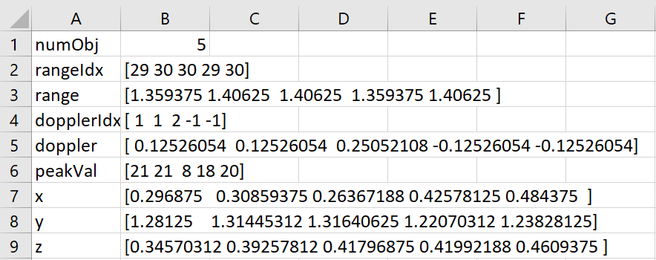
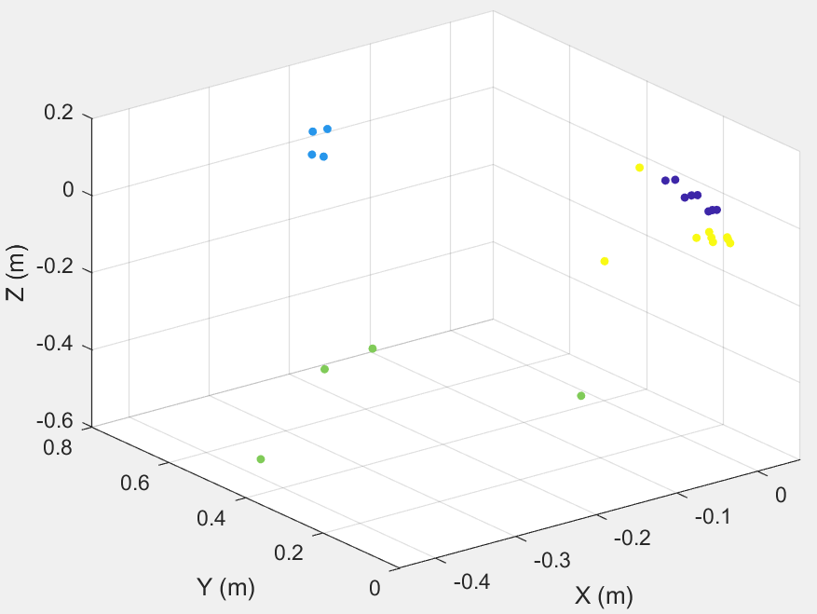
Python parser: Data manipulation and storage
Exported using the writefile method in append mode from the csv library
Variety of parameters exported to a CSV file, allowing for data to be processed in MATLAB
X, Y, and Z values plotted in MATLAB to see how it related to the environment the data came from
CSV data from detObj
Test data visualisation

Slide 5
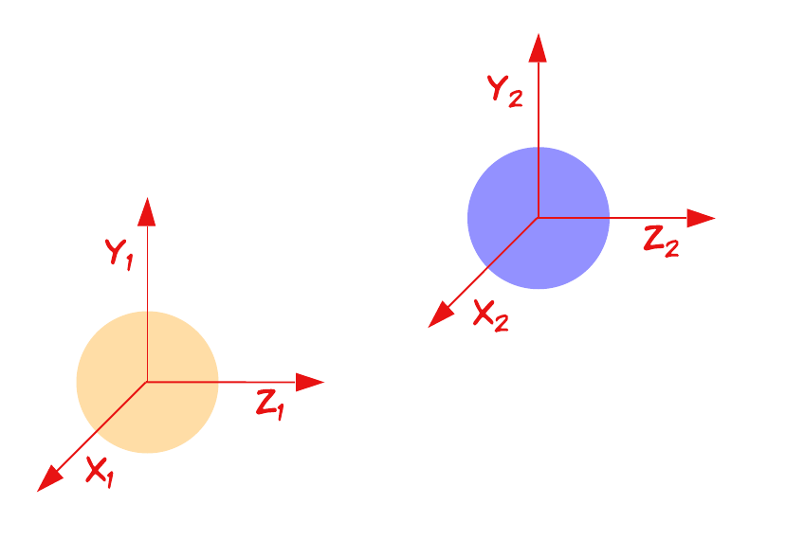
Approach 1: Distance calculation
Distance formula
(point1(x) - point2(x))^2 + (point1(y) - point2(y))^2 + (point1(z) - point2(z))
3D distance between two points

Slide 6
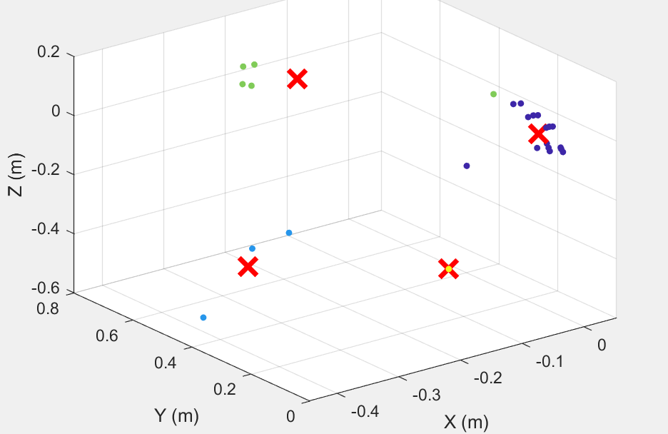
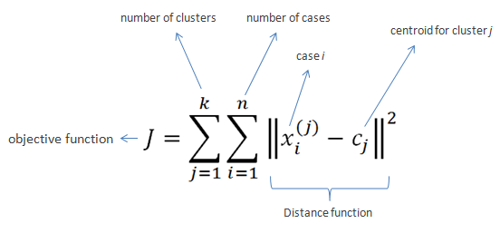
Approach 2: KMeans Clustering
Not ideal for real-time
Requires clusters to be predetermined
KMeans clustering mathematical formula
KMeans MATLAB implementation

Slide 7
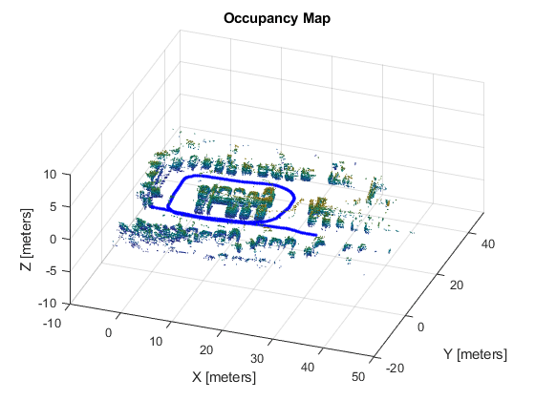
Approach 3: 3D Lidar Point Clouds
Input:
Cell array of n-by-3 matrices, where n = no. of 3D points
Columns represent xyz-coordinates associated with each captured point
Output:
Occupancy map of point cloud data
3D Lidar point cloud MATLAB visualisation

Slide 8
MATLAB & Python issues
Processing data concurrently difficult in real-time between two languages
Not ideal for when robot must process data on the move

Slide 9
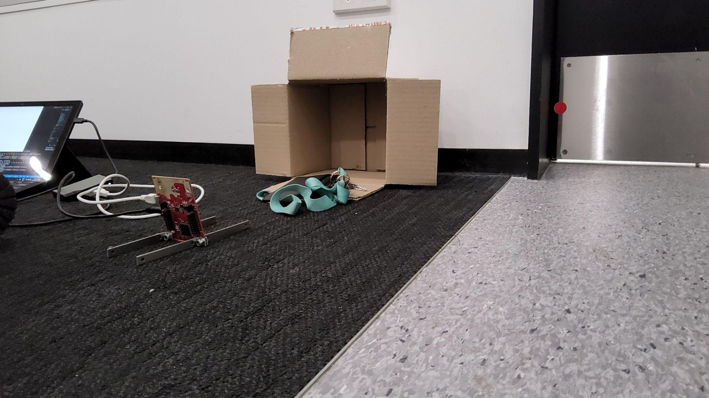
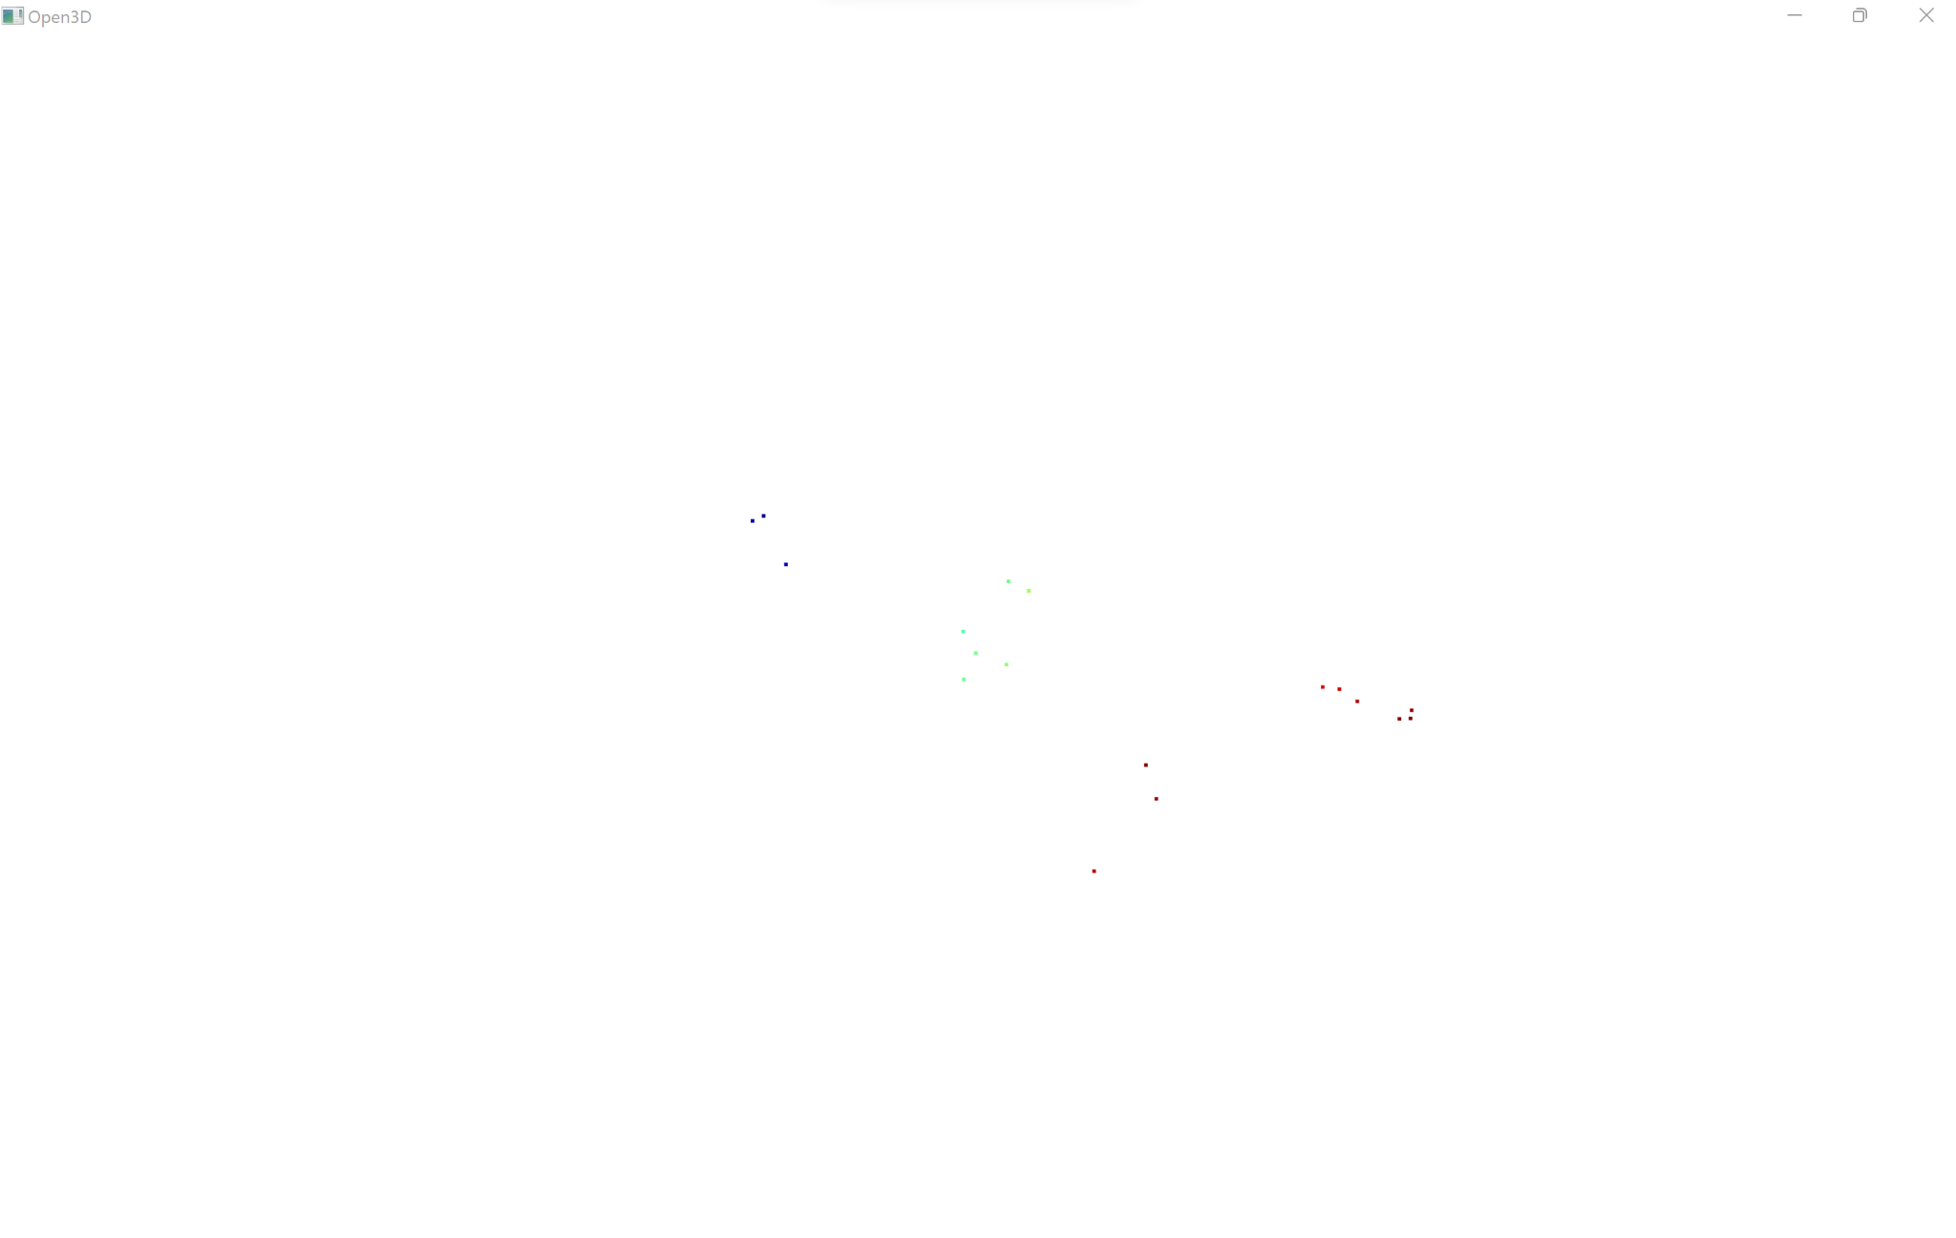
Current approach: Open3D
Ability to convert x, y, z matrix into point clouds
Visualises point clouds in Python
Plenty of resources online
Open3D real-life test
Open3D sensor output

Slide 10
Next steps
Avoid using built in keyboard control for robot movement (not autonomous)
Start developing 3D point cloud visualisations using mmWave

